Slide 1



The Rise of Cloud-Based e-Learning
The rapid growth of cloud computing has revolutionized the way we approach education. Cloud-based e-learning platforms offer unparalleled accessibility, scalability, and flexibility, empowering learners and educators alike to unlock new frontiers of knowledge and collaboration.
by Charan Kumar
192211364

Slide 2
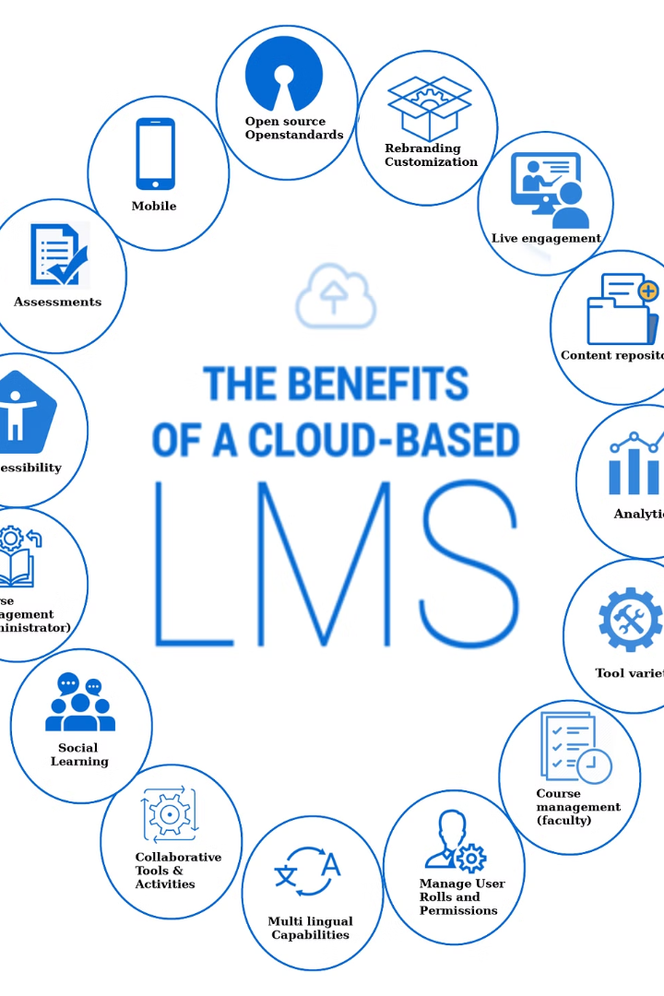
Benefits of Cloud-Based e-Learning
Cloud-based e-learning offers numerous advantages, from enhanced accessibility to scalability and cost-savings. By leveraging the power of the cloud, educational institutions can deliver more dynamic and personalized learning experiences for their students.

Slide 3

Cost-Effectiveness
Reduced Upfront Costs
Scalable Pricing
Lower IT Overhead
Cloud-based solutions offer flexible, pay-as-you-go pricing models, allowing you to scale your e-learning programs up or down as needed without major capital investments.
With the cloud provider handling server maintenance, software updates, and data storage, organizations can significantly reduce their IT support costs and focus on core business objectives.
Cloud-based e-learning platforms eliminate the need for expensive on-premise infrastructure, software licenses, and IT maintenance, making them more cost-effective for organizations of all sizes.

Slide 4

Scalability and Customization
1
Flexible Scaling
2
Personalized Learning
Cloud-based e-learning platforms allow organizations to easily scale up or down their user capacity based on evolving needs, ensuring a seamless learning experience.
These platforms offer customizable learning paths, content, and assessments, enabling learners to focus on areas most relevant to their goals and learning style.
3
Adaptive Technology
Advanced analytics and artificial intelligence power cloud-based e-learning, providing real-time insights to optimize the learning experience for each individual user.

Slide 5
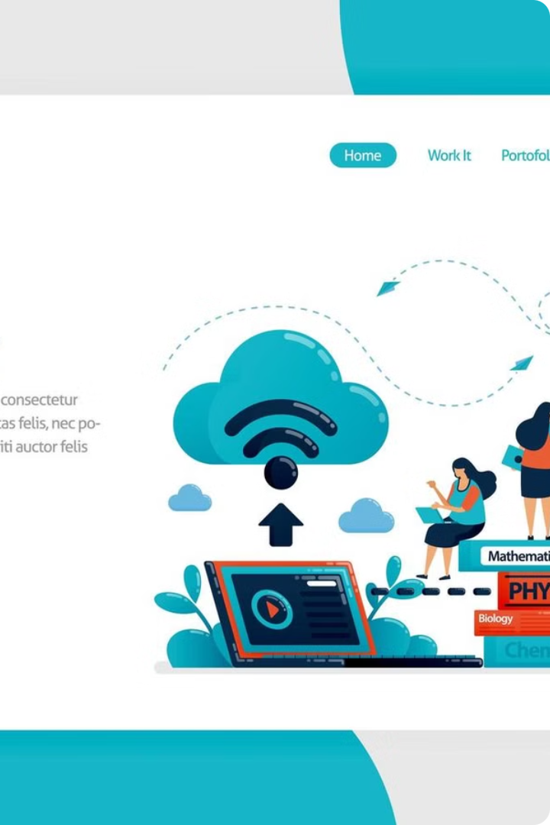
Key Features of Cloud-Based e-Learning Platforms
Cloud-based e-learning platforms offer a robust suite of features that enable engaging and effective online learning experiences. These include powerful learning management systems, adaptive content delivery, and advanced analytics to maximize student outcomes.

Slide 6
Learning Management Systems (LMS)
Streamlined Content Delivery
Personalized Learning Paths
Collaborative Tools
Comprehensive Reporting
Cloud-based LMS platforms offer a centralized hub for delivering educational content, including interactive lessons, videos, and assessments.
These systems can create personalized learning journeys based on student progress and preferences, ensuring each learner receives the right content at the right time.
Built-in discussion forums, chat functions, and file-sharing capabilities foster collaboration and communication between students and instructors.
Robust data analytics and reporting features provide valuable insights into student performance, engagement, and course effectiveness.

Slide 7
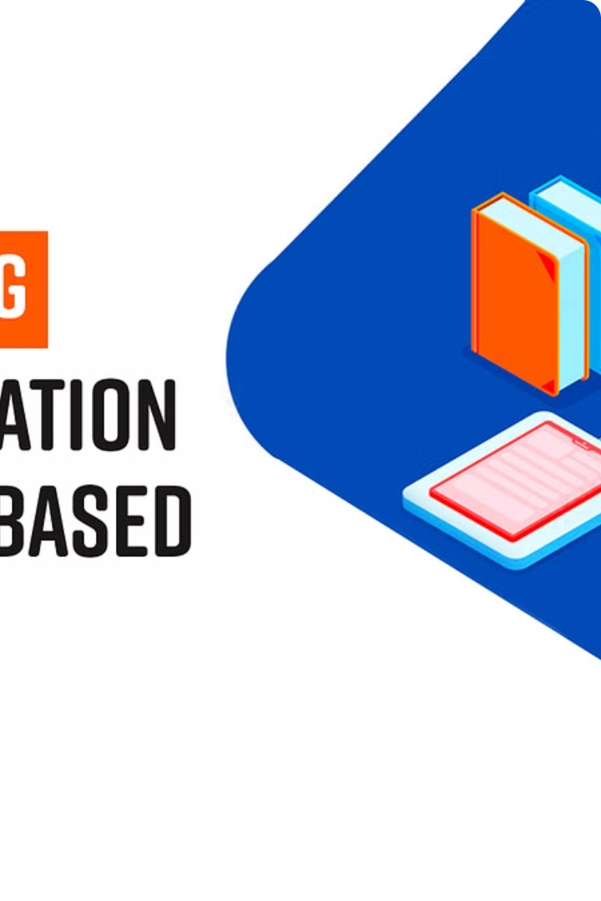
Popular Cloud-Based e-Learning Platforms
Leading cloud-based platforms that are transforming online education and training.

Slide 8
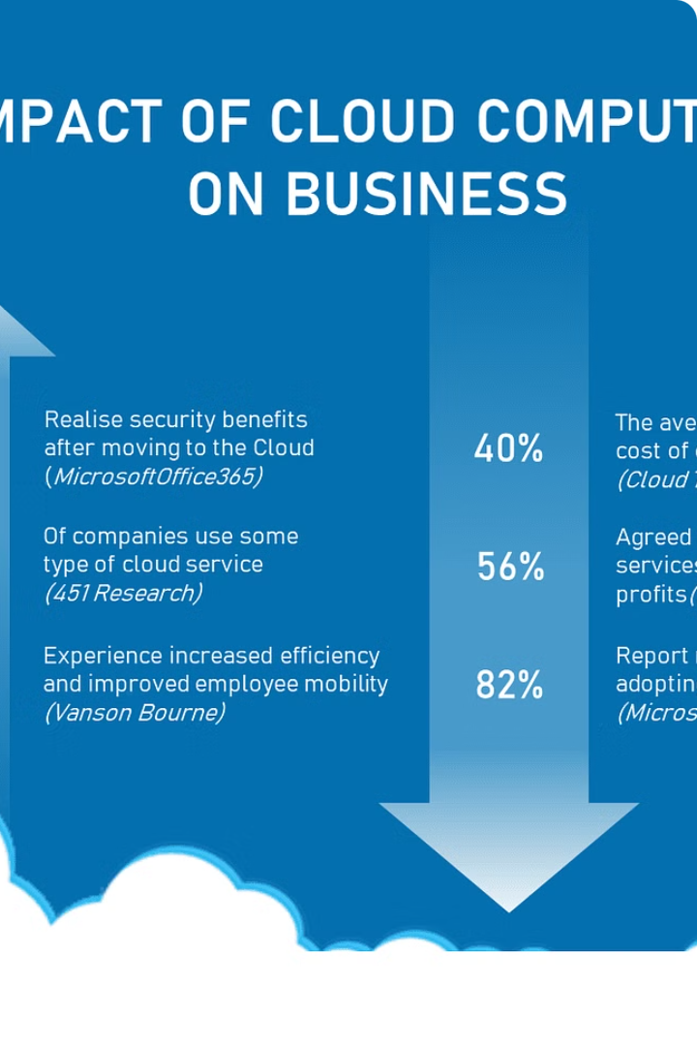
Implementing Cloud-Based e-Learning
Transitioning to a cloud-based e-learning platform requires careful planning and execution. Key steps include identifying the right platform, integrating with existing systems, and training instructors and learners.

Slide 9
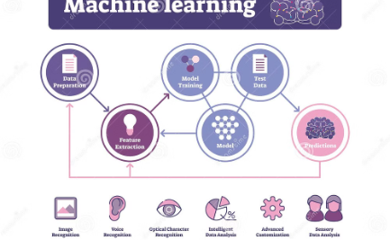
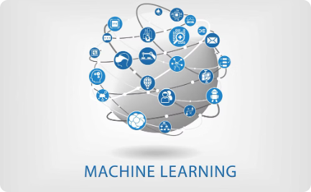

Artificial Intelligence (AI) and Machine Learning
Intelligent Automation
Adaptive Learning
Personalized Guidance
AI and machine learning algorithms can automate repetitive tasks, personalize learning content, and provide intelligent tutoring to enhance the e-learning experience.
Cloud-based e-learning platforms leverage machine learning to continuously analyze learner data and adjust the curriculum, pacing, and delivery to meet individual needs.
AI-powered virtual assistants and chatbots can provide real-time feedback, answer questions, and offer personalized recommendations to support learners throughout their e-learning journey.

Slide 10

Conclusion: The Future of Education is in the Cloud
As technology continues to reshape the educational landscape, cloud-based e-learning platforms are poised to become the cornerstone of the future of education. These flexible, scalable, and data-driven solutions offer unparalleled opportunities for personalized learning, seamless collaboration, and real-time insights that will redefine the student experience.

